Slide 1

Council Briefing
18/12/24

Slide 2
Financial Report Components
Operating Statement
Income
Rates & Annual Charges
User Charges & Fees
Other Revenues
Grants & Contributions for Operating
Grants & Contributions for Capital
Interest & Investment Revenue
Other Income (gain on disposal of assets)
Total Income from Continuing Operations
Expenditure
Employee Costs
Materials, Contracts & Other
Borrowing costs
Depreciation
Other Expenses
Loss on disposal of asset
Total Operating Expenditure
Net Operating
Net Operating before Grants & Contributions for Capital (capital grants removed)
Capital Works
Expenditure on
  Renewal of Assets
  Replacement of Assets
Expenditure on
  New Assets
  Upgraded Asset
Capital Grants
Asset Expenditure
Maintenance (ie potholes) = Operating
Renewal/replacement (ie resealing) = Capital
New/Upgrade (dirt to sealed) = Capital

Slide 3
Depreciation: the tale of two machines
Bill
Has $100,000
Buys a machine for $100,000
Bank account = Nil
Machine lasts 10 years
Deteriorates by $10,000/year (Depr)
$150,000 per year income
Less expenditure of:
$30,000 general costs
Result = $120,000 taken as a wage
In 10 years’ time Bill’s machine has deteriorated and needs replacement and he has to borrow $100,000
Ted
Has $100,000
Buys a machine for $100,000
Bank account = Nil
Machine lasts 10 years
Deteriorates by $10,000/year (Depr)
$150,000 per year income
Less expenditure of:
  $30,000 general costs
  $10,000 depreciation
  (deterioration of machine)
Ted uses $10,000/yr to ‘renew’ machine
Result = $110,000 taken as a wage
In 10 years Ted’s machine has been renewed each year which has extended its life and it still has a life of 10 yrs.

Slide 4
Monthly Financial Report
Consolidated Income Statement
Income Statement Variance Analysis
Income Statement by Fund
Statement of Financial Position
Reserves Balance
Capital Expenditure
Crago Mill Progress Report

Slide 5
Reserves
Cash set aside for specific purposes
Externally Restricted (legislation)
  Developer Contributions
  Waste
  Sewer
  Water
  Others
Internally Restricted (council resolution)
Reserves are cash from previously recognised income
Example | In | Out | Balance
Developer Contributions | $500k |  | $500k
Following year (s) |  | $300k | $200k

Slide 6
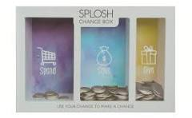
Reserves – Internally Restricted
Multiple reserves
Complicated
Add time and cost to accounting
Delays reporting
Not efficient
Better to be as simple as possible – only have a reserve where needed

Slide 7
Reserves (ignores capital)
 | Ideal | Not Ideal
Cash in Bank (not reserves) | $10m | $10m
Council Operating Income (not including capital grants) (includes Developer Contributions of $1m – unspent by end of year) | $40m | $40m
Council Operating Expenditure (not including depreciation $10m) | -$25m | -$50m
Cash in Bank | $25m | $0m
Reserve Opening balance | $5m | $5m
Add Developer Contributions | $1m | $1m
Reserve Closing balance | $6m | $6m
Cash in Bank (not reserves) | $24m | -$1m
Includes - Depreciation for renewal of capital | $10m | Haven’t funded depr

Slide 8
Capital
 | Ideal | Not Ideal
Depreciation | $10m | Not funded
Capital Grants and Contributions | $10m | $10m
Capital Expenditure | $20m | $20m
Balance | $0 | -$10m
 |  | Where is the cash to fund this?

Slide 9
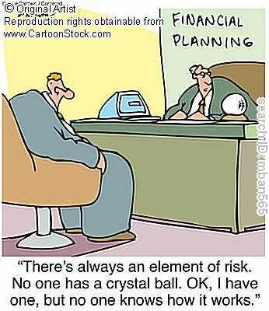
Long Term Financial Plan

Slide 10
Long Term Financial Plan
Takes all the information from all the plans and sets out the financial consequences in the form of financial statements over a number of years.
At least 10-year plans but can be longer, review annually – or more often
Includes assumptions about:
Inflation – CPI
Grants
Rates
Service Levels
  Other cost pushes:
    Waste charges (Govt Levies)
    Utilities
    Insurance

Slide 11
YASS LTFP
Income Statement (Operating Plan) shows capital grants but doesn’t show the capital expenditure
We have included capital expenditure to show the end result
Doesn’t show the effect on cash

Slide 12
Lets look at cash only

Slide 13
Add in Reserves and Borrowing
Cumulative Effect of Cash Flow
All money that we can use comes from the Income Statement
Reserves came from income in previous years
Borrowing has to be paid back

Slide 14
Grants – A Cautionary Tale
Grants are not free money (usually)
Usually, they are tied to a specific project
Sometimes grant is $2 for $1 which means that council must contribute
Even if a capital project is fully funded
Grant | $5m
Capital project - building | -$5m
Net | 0
Each year
Depreciation (approx. 2% for future renewal) | $100k
Maintenance (approx. 0.5%) | $25k
Total cost each year – council cost | $125k

Slide 15
What can we do to improve long-term financial sustainability?
Council must balance net operating results before capital grants
Council must also improve its long-term unrestricted cash position
Some options are:
    Cut Operating Projects
    Cut Capital Projects
    Asset Management Plans – Condition Assessments and Planning
    Levels of Service – operational and capital
    Review of allocation of costs between funds – doesn’t change cash position.
    Review the use of Reserves
    Special Rates Variation

Slide 16
Asset Management Plans
Should consider:
Level of Service & Risk Concerns
Condition of Assets
Growth effect on asset requirements
Provides:
Annual maintenance requirements
Depreciation $
Renewal/Replacement requirements
New/upgrade requirements to cope with growth
Capital Projects should address the Asset Management Plan requirements
New and Upgrade outside of this – considered very carefully
Fund Depreciation full by having a zero Net Result – funds for AMP

